Slide 1
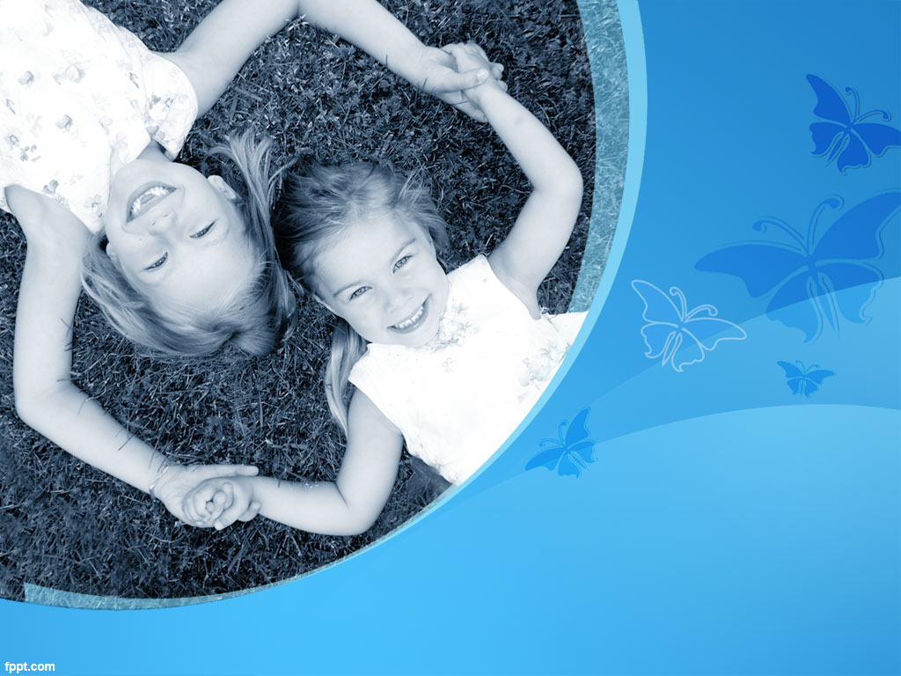
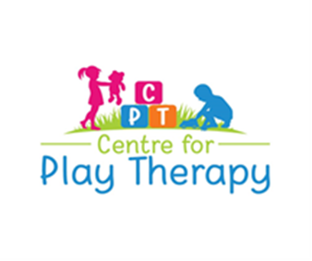
Play Therapy and Trauma:
The Power of Play to Heal
By Kylie Ellison
BA (Psyc), PostGrad Dip Psyc,
MA Coun & Psychotherapy

Slide 2

Presentation Overview
What is Child Centred Play Therapy (CCPT)?
History and meaning of play for children
Core principles of the approach
Empirical evidence and objectives of CCPT
Characteristics of a play therapist
Versions of a play therapy room
What is trauma?
Definition of trauma
How does it present in children- memory, conscious vs unconscious mind
What are the benefits of Child Centred Play Therapy with traumatized children
Interplay between CCPT and trauma
Experiences of trauma in the play room
Recommendations for future applications/ contact details

Slide 3
Trigger and Content Warning
Our program provides an open space for the critical and civil exchange of ideas, and the respectful sharing of information and stories. Please observe our environment of sensitivity and mutual respect.
Some content might include topics that you may find disturbing, including sexual abuse, self-harm, violence, and so on, and can take the form of an image, video clip, audio clip, or piece of text. It is your right to step away and take a break at any point.
If you find any of this content difficult or overwhelming, I encourage you to reach out to me via zoom direct message or a friend or family member that you trust.
Alternatively, you can contact Lifeline 13 11 14 or Beyond Blue 1300 22 4636.

Slide 4
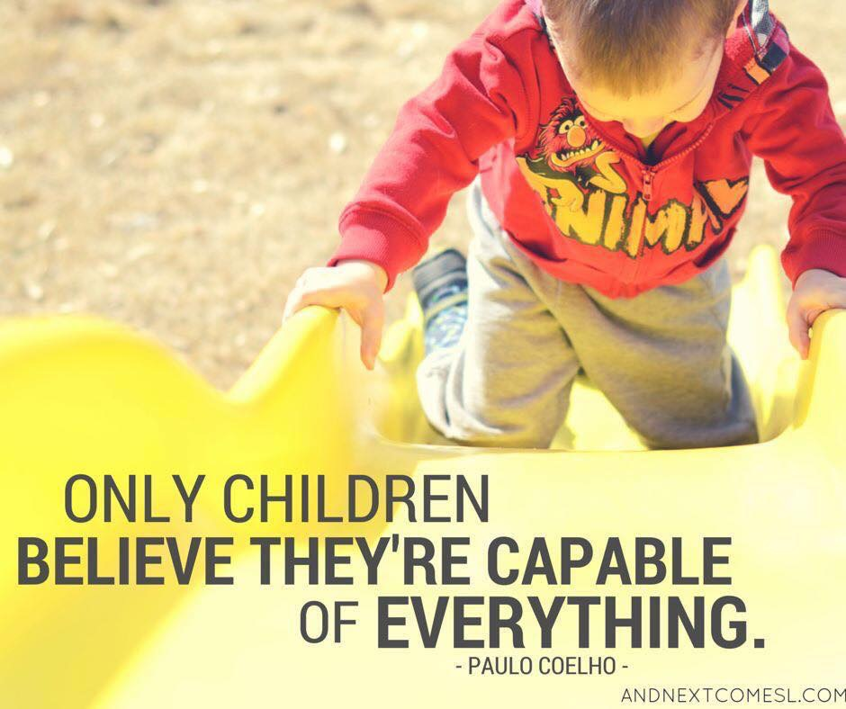
History and meaning of play for children
Our ability to play freely for play’s sake has been lost.
In the past 30 years there has been a cultural shift towards focusing work and “getting ahead”.
Many believe that the amount of free time we have to use for play has decreased since the 1970’s, after having steadily decreased since the Industrial Revolution. The increase in a focus on 9- 5pm, Monday to Friday work schedules and a general cultural rejection of “free time” in favour of materialism and productivity thought to have impacted our opportunities now for “free time”.

Slide 5
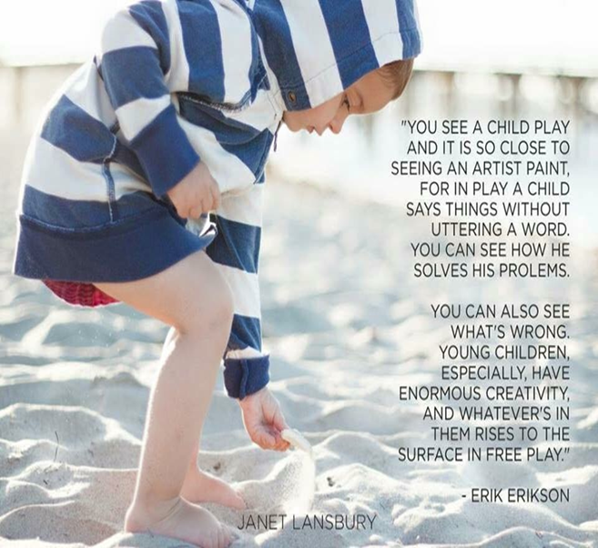
History and meaning of play for children
Highest expression of humanity.
Primal purpose to ensure our survival.
Humans are among the few animals on earth that play as adults.
How we play is related in a number of was to our core sense of self. Play is an exercise in self-definition, it reveals what we choose to do, not what we have to do. We not only play because we are, we play the way we are. And the ways we could be. Play is our free connection to pure possibility.

Slide 6
History and meaning of play for children
“It is in playing and only in playing that the individual child or adult is able to be creative and to use the whole personality, and it is only in being creative the individual discovers the self” (Winnicott, 1971. P.54).
Play can increase our self esteem.
When relaxed in play we often have increased capacity for empathy and intimacy.
Play permits emotional discharge, but in a way that carries little risk.
Play provides new ways of exploring reality and different strategies to deal with it; play favours space for spontaneous action in a world where most things are regulated.

Slide 7
History and meaning of play for children
Current research on play
Dr Peter Gray, a leading researcher in the field of play and it’s decline, notes how over the last 50 years children’s ability to play freely has been lost.
Dr Gray highlights the decrease in free play leading to children being unable to have the opportunity to play out and make sense of their world, and resolve issues for themselves
As a result, children nowadays have more of an external locus of control- believing things are happening to them that they can’t control- which is leading to an increase in children experiencing anxiety and depressive symptoms
https://www.youtube.com/watch?v=Bg-GEzM7iTk

Slide 8
What is Child Centred Play Therapy?
What is Child Centred Play Therapy?
Introducing Andrew….
https://www.youtube.com/watch?v=reJpo-GaopM

Slide 9
What is Child Centred Play Therapy?
First developed by Virginia Axline in 1947, non-directive/ child centred play therapy (CCPT) is based on the work of Carl Rogers (1951) whose client centred approach to adult therapy influenced Virginia Axline’s ideas about treatment for troubled children.
CCPT is based on belief that children thrive in a relationship of unconditional positive regard in which the therapist demonstrates genuine interest and unqualified acceptance of the child, and allows the child freedom to explore and to express themselves completely.
The therapist shows sensitivity to the child’s feelings by gently reflecting those feelings, demonstrating a belief in the child’s capacity to act responsibly and sets appropriate therapeutic limits.
CCPT maintains the basic assumption that play therapy can be most effective when the therapist does not direct but allows the child to take responsibility for the direction of the play therapy agenda.

Slide 10
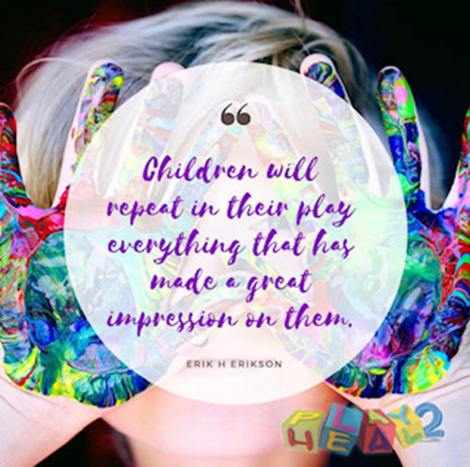
What is Child Centred Play Therapy?
CCPT focuses on the child and not his or her problems.
“Play is their language, toys are their words” (Landreth, 2012)
Children with nearly every type of presenting problem or condition benefit from play therapy including:
Divorce
Trauma
ADHD
ASD
Death/ grief/ loss
Chronic illness
Physical or sexual abuse
Domestic violence
Social issues/ relationship issues

Slide 11
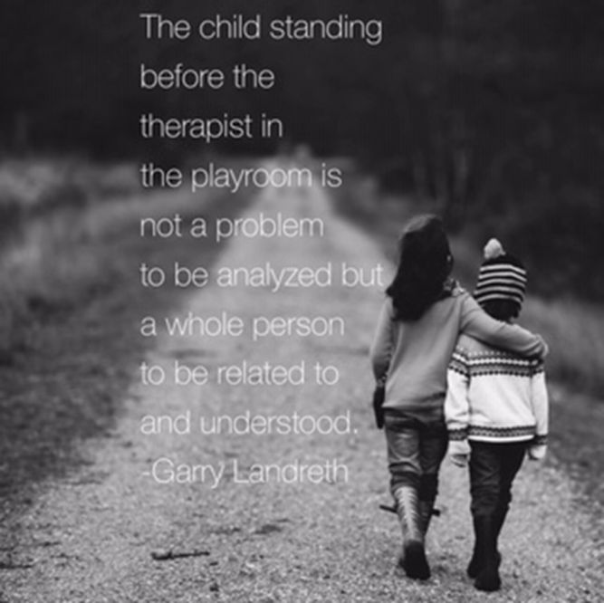
What is Child Centred Play Therapy?
Attitude of deep and abiding belief in the child’s ability to be constructively self- directing
CCPT is intentional about looking through the child’s eyes to understand the child’s perception of self and experiences
The power to change resides within the child and is not a result of direction, advice or information the therapist might have to offer
Trust the child to lead the experience of therapy where the child needs to be

Slide 12
What is Child Centred Play Therapy?
Empirical evidence supporting CCPT
Accumulated empirical and clinical evidence demonstrates that client self-direction is indeed effective with children and adults, across a wide variety of problems from mild to severe (Guerney, 2001).
Research demonstrates the efficacy of CCPT in treating a variety of childhood problems. CCPT can significantly reduce aggressive behavior, separation anxiety and speech disturbance in preschool children, with studies supporting the therapeutic use of CCPT with children of parents struggling with issues such as substance misuse, mental health issues and domestic violence.
Meta- analytic review of CCPT approaches of 52 controlled outcome studies between 1995 and 2010 indicated a statistically significant moderate treatment effect size, indicating statistically significant relationships between effect size and study characteristics including the child’s age, ethnicity, caregiver involvement and presenting issue.

Slide 13
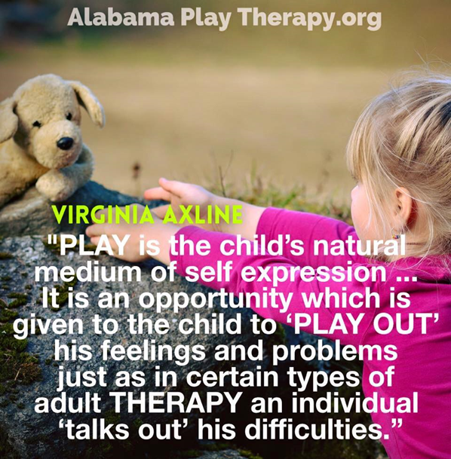
What is Child Centred Play Therapy?
Objectives in CCPT:
Develop a more positive self- concept
Assume greater self- responsibility
Become more self- directing
Become more self- accepting
Become more self- reliant
Engage in self- determined decision making
Experience a feeling of control
Become sensitive to the process of coping
Develop an internal source of evaluation
Become more trusting of themselves

Slide 14

What is Child Centred Play Therapy?
What do children learn in play therapy?
Respect for themselves
That feelings are acceptable
How to express feelings responsibly
Assume responsibility for themselves
To be creative and resourceful in confronting problems
Self- control and self- direction
To make choices and be responsible for those choices

Slide 15
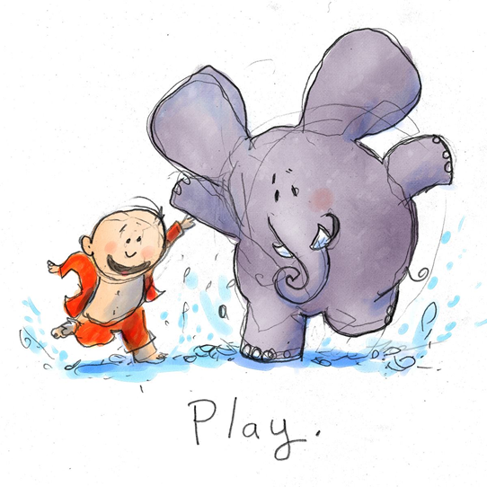
What is Child Centred Play Therapy?
Eight humanistic tenets of therapist stance regarding the child (in line with eight principles of Virginia Axline):
Unqualified acceptance
Genuine interest
Safety and security to explore, experience and express
Sensitivity and reflexivity privileging child insight and self understanding
Faith in child ability to resolve difficulties
Trust in child’s capacity to lead therapeutic relational thrust
Respect for gradual therapeutic process
Limit- setting, linking therapeutic experience with real world leads to child taking responsibility for actions

Slide 16
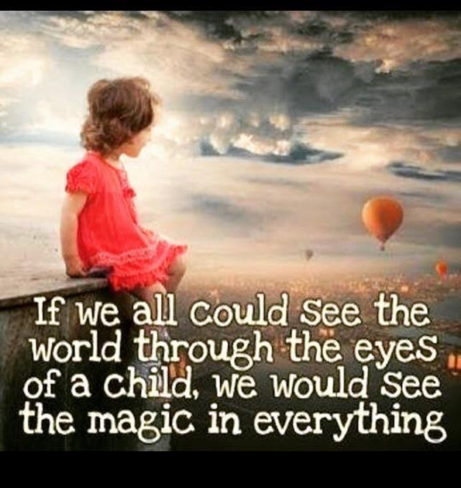
What is Child Centred Play Therapy?
Characteristics of a Play Therapist
Personality characteristics (emphasis on intentionality rather than attainment!):
Objective and flexible
Does not judge or evaluate
Open- minded
Patient
High tolerance for ambiguity
Personal courage
Being real, warmth, caring acceptance and sensitive understanding
Sense of humour! ☺

Slide 17
Versions of a Play Therapy Room
Play therapy can be conducted in a variety of spaces
Important to consider confidentiality when deciding on a space
Selection of toys is a deliberate process based on the basic rationale that using play therapy with children is a recognition of the child’s developmental level expressed naturally through play

Slide 18
Versions of a Play Therapy Room
Categories of toys
Real- life toys
For example- dolls, figurines, doll’s house, puppets, car, truck, ambulance, cash register, telephone
Aggressive toys
For example- sword, guns, handcuffs, blow up doll
Creative expression/emotional release toys
For example- Sand, water, paint, playdough, blocks

Slide 19
Versions of a Play Therapy Room
Stages of Play
Children progress through the four stages of play including exploratory play, aggressive play, regressive play and mastery
Toys in the room are specifically selected for each stage of play, to assist children to work through their issues
Children will often step in and out of these stages depending on events occurring outside of the playroom, or issues being addressed in the play room
Pro-social behaviour- we also look to identify these to identify strengths in the child (such as manners, sharing, care- taking, respect, self-control, apologising, empathy, problem-solving) and seek to readily identify these for the child in the playroom

Slide 20
Versions of a Play Therapy Room
Themes
There are a number of themes that children will explore in their therapy work as they progress through therapy
These themes include but are not limited to:
Relationship (connecting, trust, approval seeking, manipulative, limit testing)
Boundaries/ intrusion
Dependence/ independence
Helplessness/ inadequacy
Aggression/ revenge
Self- esteem/ self worth
Safety/ security/ protection
Nurturing/ healing
Death/ loss
Power/ control
Exploratory
Fears/ anxiety
Good vs evil
Trust/ betray;
Anger/ sadness

Slide 21
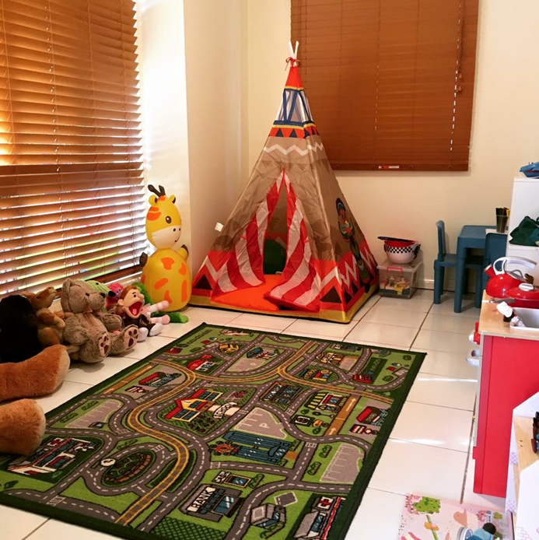
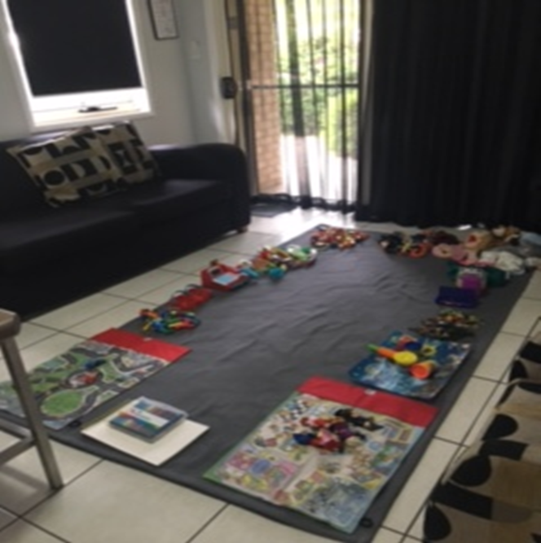
Versions of a Play Therapy Room

Slide 22
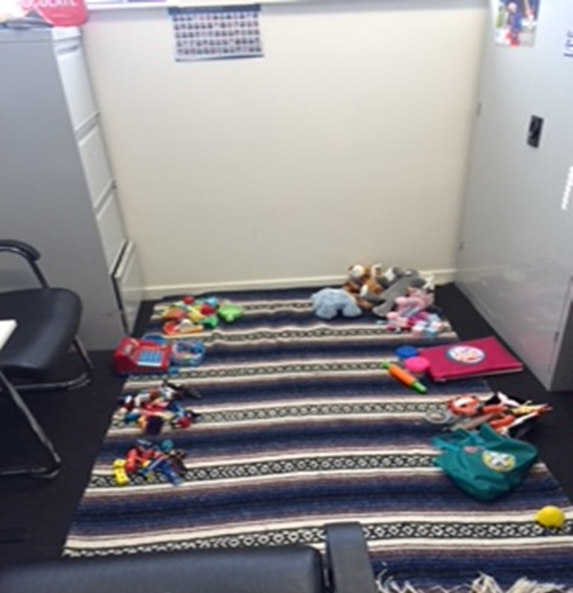
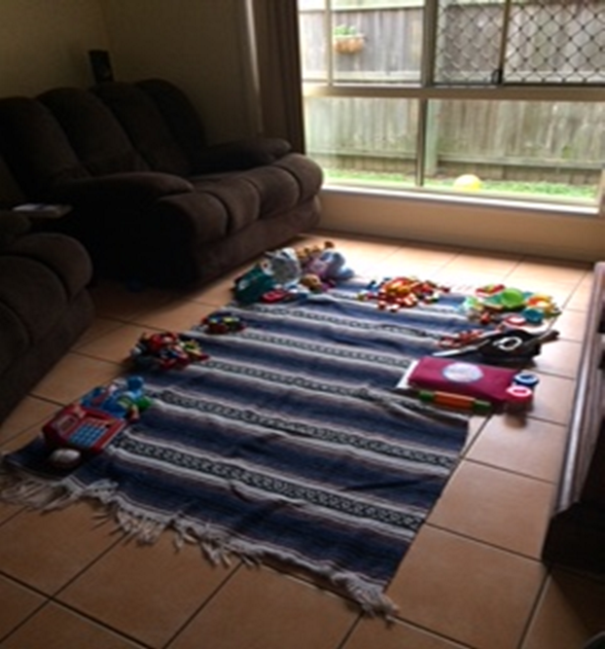
Versions of a Play Therapy Room

Slide 23
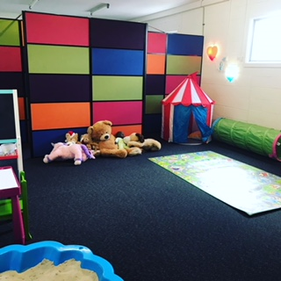
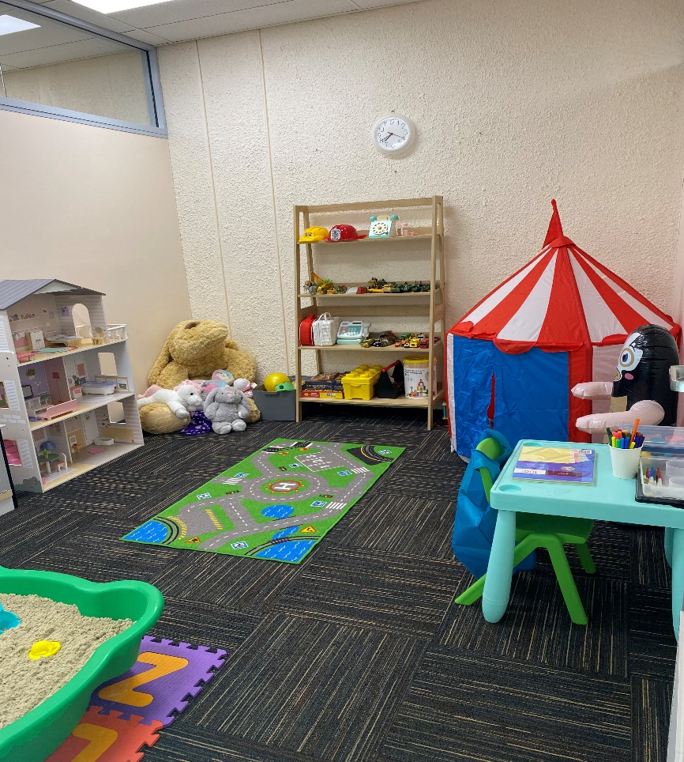
Versions of a Play Therapy Room

Slide 24
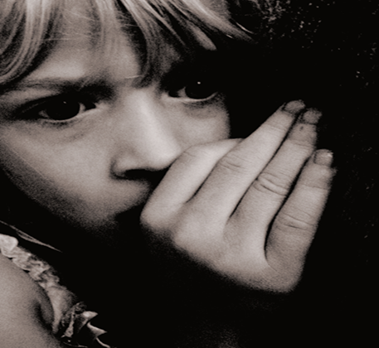
What is Trauma?
How researchers describe trauma….
“A psychologically distressing event that is outside the range of usual human experience, often involving a sense of intense fear, terror or helplessness” (Bruce Perry)
“Traumatic events overwhelm, challenge and question people’s expectations of their safety and how their world works”. (www.kidsmatter.edu.au)

Slide 25
What is Trauma?
Complex Trauma
Acute or Simple Trauma: from one overwhelming traumatic event
Complex or Developmental Trauma: from ongoing exposure to fear and helplessness
In terms of both experience and effect...“exposure to complex interpersonal trauma is qualitatively distinct from acute trauma...” (Kinniburgh et al., 2005)
‘Complex trauma’ describes the experience of multiple, chronic and prolonged, developmentally adverse traumatic events, most often of an interpersonal nature... and early life onset” (van der Kolk, 2005)
Multiple experiences of trauma will affect a child’s sense of control, and as a consequence increase the child’s vulnerability and hopelessness (Ogawa, 2004)

Slide 26
What is Trauma?
Trauma and Memory
The Amygdala is our storage facility for all our memories
There is two types of memories stored in the amygdala: explicit memories (such as facts, events, images) and implicit memories (such as sensations and feelings)
Research suggests that most people struggle to remember any specific explicit memory before around the age of 3 years, however the memories in our formative years are still stored in our brains as implicit memories
“It turns out the vast amount of our memory is implicit, and it is these memories that shape our emotional experiences, self-image and relationships. Despite our lack of explicit memory for many childhood experiences, they come to form the infrastructure of our lives” (Cozolino, 2006)

Slide 27
What is Trauma?
Conscious vs Unconscious mind
The influence of the concepts of the conscious and unconscious mind relate heavily to child centred play therapy work- with the origins of the approach in psychoanalytic theory
In simple terms, the concept of the conscious mind tends to emerge around six years of age, and is associated with the most recent addition to the brain, the prefrontal cortex. Human consciousness is characterized by an awareness of “self.”
The significance of the developmental spectrum is that an individual does not generally sustain active consciousness until after five years of age. Before birth and through the first five years of life, the child is primarily in sub-conscious state of mind.

Slide 28
What is Trauma?
Conscious vs Unconscious mind
During this time it is down-loading biology-controlling perceptions without conscious discrimination. The potential of a child is “programmed” into its subconscious mind during this phase of development (Dr Bruce Lipton).
In simple terms, this means a child uses the environment around them to determine how to respond to stimuli, communicate with others and self-regulate. Therefore, if a child is exposed to negative stimuli for the first 5 years of their life, this exposure becomes their “program”.
To overwrite these early experiences we need to use repetition or access the sub-conscious mind- such as through the engagement in activities such as play therapy.

Slide 29
Interplay between Trauma and CCPT
One of the earliest landmark studies in the area of trauma and CCPT was Terr (1979) who studied kidnapped children in California. Terr (1979) identified children’s unique traumatic responses, including tendency to relive their trauma through re-enactment such as trauma-inspired play, and the limitations of applying adult treatment methods to children- emphasizing the importance of play and play therapy
Shen (2002) studied children in Taiwan who had been victims of an earthquake in 1999 who were supported through use of CCPT. Results demonstrated significant reduction in children’s anxiety and suicidal risk, supporting use of CCPT.
A number of studies related to application of CCPT with children exposed to domestic violence include Frick-Helms (1997); Kot, Landreth & Giordano (1998); Smith (2000).

Slide 30
Interplay between Trauma and CCPT
Terr (1991) identified four characteristics that children display following a traumatic event:
Similar to adults who experience flashbacks, children experience recurrent and intrusive thoughts, visual recollections of the event through drawings and play;
Repetitive behaviours such as re-enactment of the event through play- termed abreactive play;
Trauma- specific fears or avoidance of stimuli highly associated with the traumatic event;
Changed attitudes about people, aspects of life or future- “futurelessness”

Slide 31
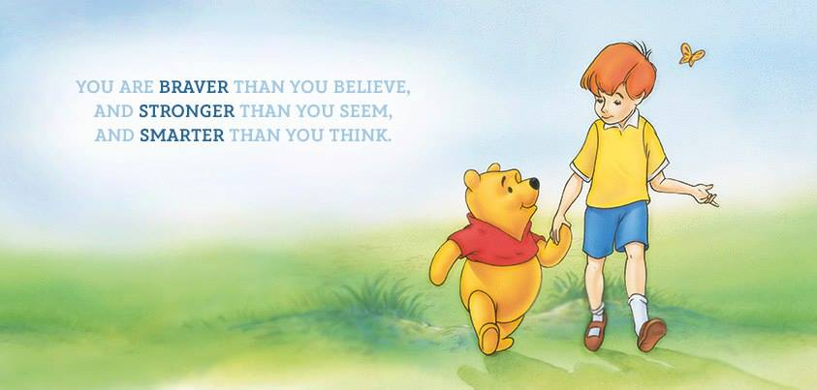
Interplay between Trauma and CCPT
Children’s responses to trauma are different to adults. Developmentally children may not be able to talk about an event directly- may be interpreted as avoidance. Children may communicate their experience in other ways, such as by playing it out.
Immediate therapeutic intervention is critical for children who have experienced trauma in order to minimise the effects of the distressing event and to prevent long- term psychological disturbance
Effects of trauma can be mediated by their own internal protective factors such as self- esteem, self- confidence and problem solving skills
Play therapy is the recommended therapeutic approach because play is the child’s natural means of expression and play enables the child to distance from the traumatic event through the use of symbolic materials

Slide 32
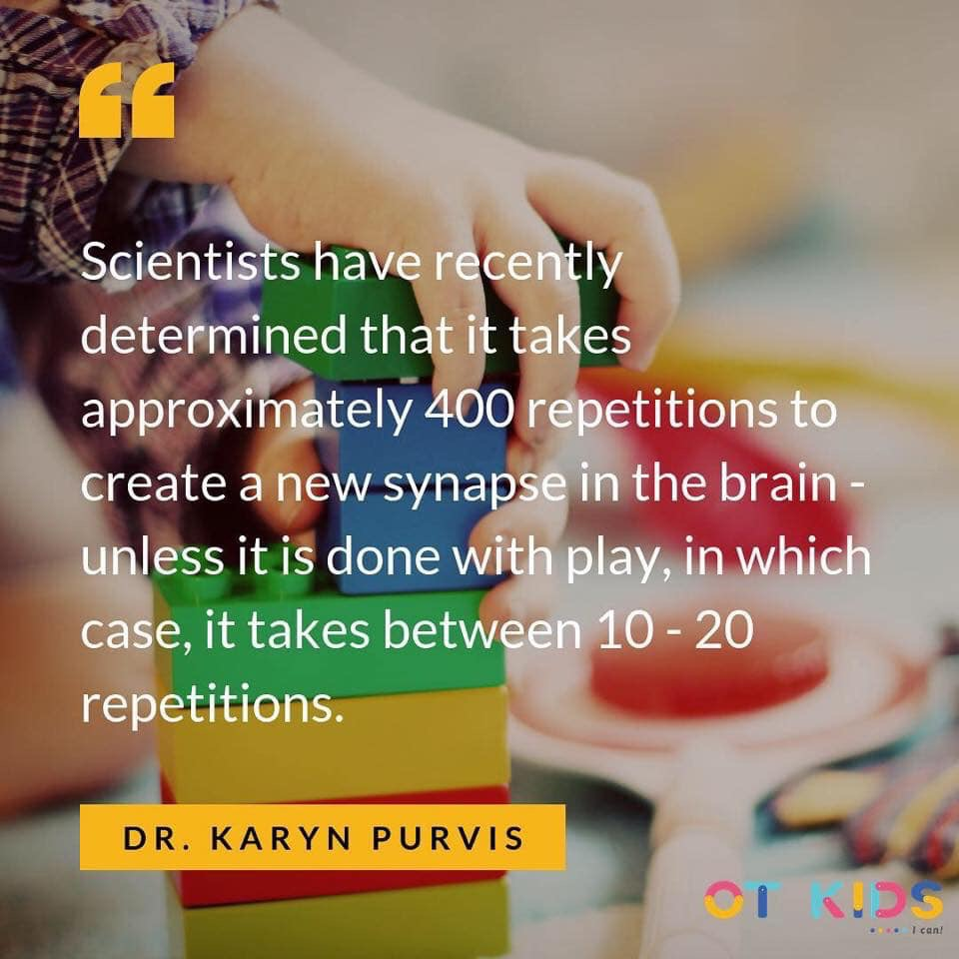
Interplay between Trauma and CCPT
Play protects the child by providing the child the opportunity to work through external difficulties without having to identify and label the painful incident as his own
This process allows children to work through extremely traumatic events without being further challenged to communicate these confusing events to adults
Bettelheim (1987) stated “play is also a ‘royal road’ to the child’s conscious and unconscious inner world; if we want to understand his inner world and help him with it, we must learn to walk this road”
(pg. 35)

Slide 33
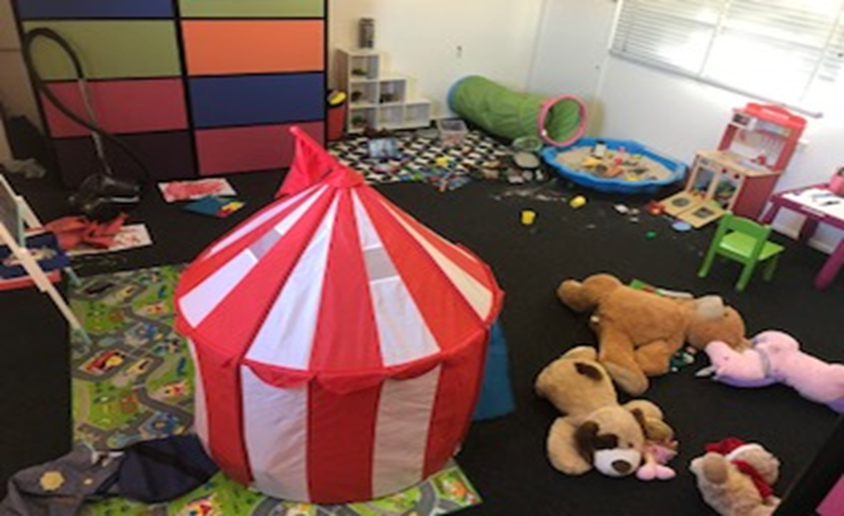
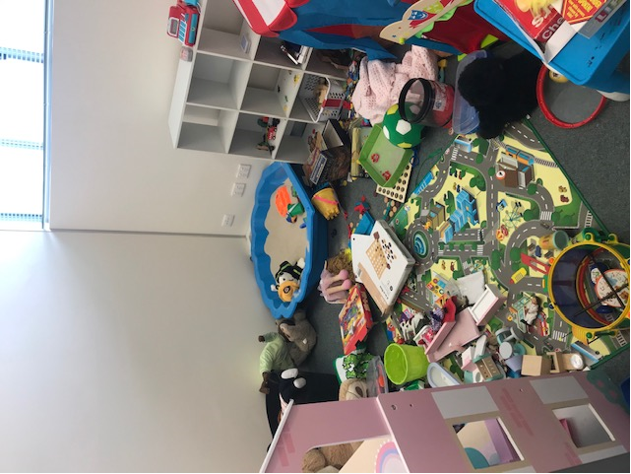
What Trauma Looks Like in the Play Therapy Room

Slide 34
Recommendations for future applications
Research and application of child centred play therapy into practice continues to evolve, with further research needed on the application of child centred play therapy with traumatized children, with a particular focus on different experiences of harm (such as sexual harm, domestic violence, physical abuse).
New approaches such as Synergetic Play Therapy are beginning to link the neurobiology of trauma with the application of play therapy- further research to inform practitioners of the best approaches to treating traumatized children is recommended
Play therapy can be offered in a variety of settings including schools, hospitals, private practice and agencies- continued exploration of the application of this approach to meet the needs of traumatized children in a variety of settings is highly recommended
Ongoing professional development and access to training opportunities for those interested in practicing as a play therapist important to ensure more children are able to access play therapy services across Australia

Slide 35
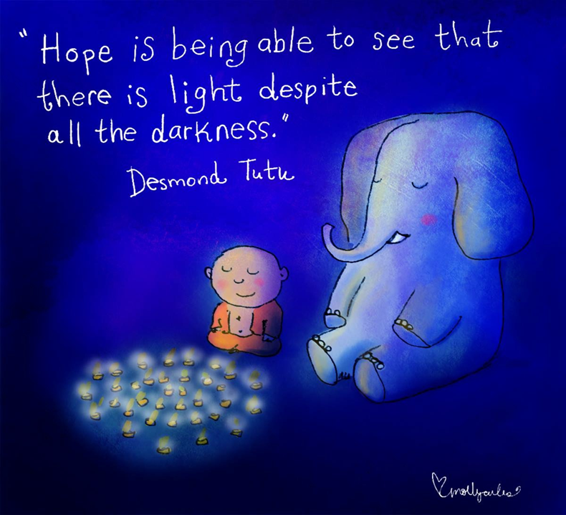
Any questions?

Slide 36
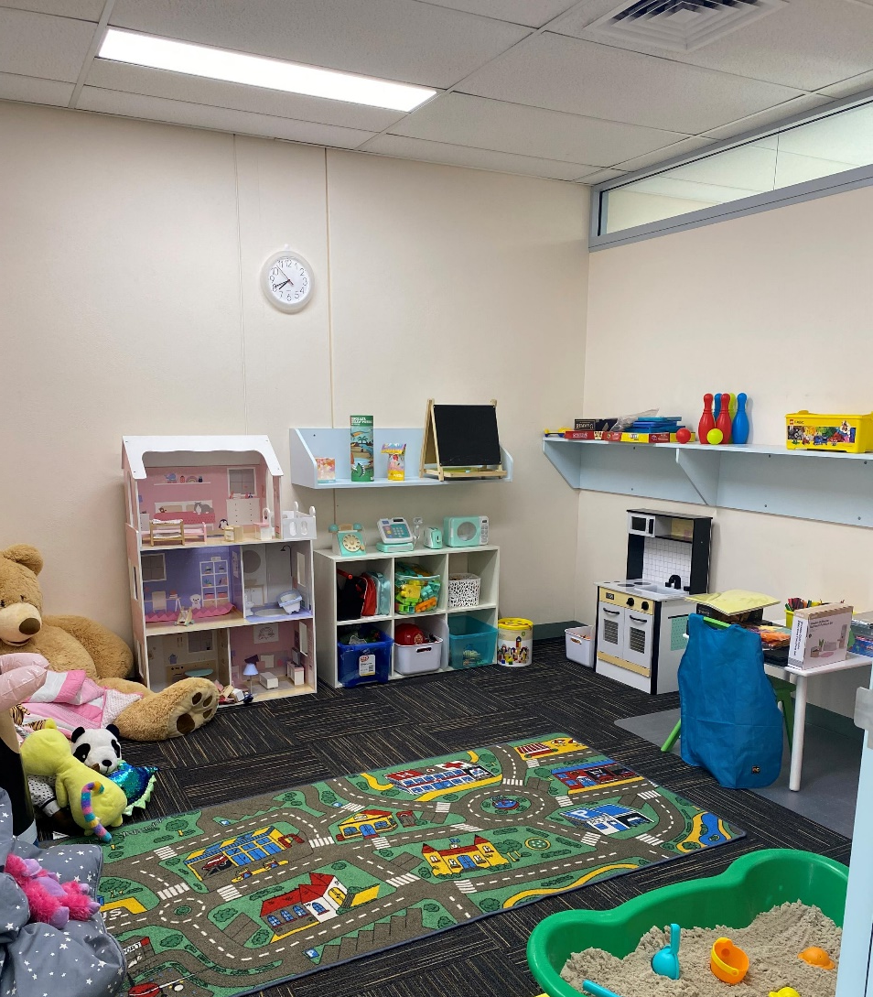
Contact details
For further information about Child Centred Play Therapy, contact us at Centre for Play Therapy:
Website- www.centreforplaytherapy.com.au
FB/ Instagram- @centreforplaytherapy
Email- kylie@c4pt.com.au
Ph: 1300 424 752
Other resources:
www.playtherapypractitionersassociation.com.au
www.playtherapytrainingaustralia.com.au

Slide 37
Reference List
Axline, V. (1969). Play therapy. Boston: Houghton Mifflin.
Bettelheim, B. (1987). The importance of play. Atlantic Monthly, 3, 35- 46.
Cozolino, L. (2002). The Neuroscience of Psychotherapy: Building and Rebuilding the Human Brain. W. W. Norton: New York.
Frick- Helms, S. B. (1997). “Boys cry better than girls”: Play therapy behaviours of children residing in a shelter for battered women. International Journal of Play Therapy, 61, 73- 91.
Guerney, L. (2001). Child centred play therapy. International Journal of Play Therapy, 10, 13- 31.
Kinniburg, K, Blaustein, M., Spinazzola, J., and van der Kolk, B. (2005). Attachment, self-regulation and competency: A comprehensive intervention framework for children with complex trauma. Psychiatric Annals, 33(5), 424-430.
Kot, S., Landreth, G. L., & Giordano, M. (1998). Intensive child centred play therapy with child witnesses of domestic violence. International Journal of Play Therapy, 7 (2), 17- 36.
Landreth, G. L. (2012). Play therapy: The art of the relationship. New York: Routledge.
Lipton, B. (2012). Nature, nurture and human development. Retrieved from https://www.brucelipton.com/resource/article/nature-nurture-and-human-development
Ogawa, Y. (2004). Childhood trauma and play therapy intervention for traumatized children. Journal of Professional Counselling, Practice, Theory & Research, 32 (1), 19- 29.
Perry, B. (2006). Applying principles of neurodevelopment to clinical work with maltreated and traumatised children, in Webb, N. [Eds] Working with Traumatised Youth in Child Welfare. Guildford Press: New York.

Slide 38
Reference List
Perry, B. and Szalavitz, M. (2006). The Boy who was Raised as a Dog: What Traumatised Children can Teach us about Loss, Love and Healing. Basic Books: New York.
Rogers, C. (1951). Client-centred therapy. Boston: Houghton Mifflin.
Shen, Y. (2002). Short term group play therapy with Chinese earthquake victims: Effects of anxiety, depression and adjustment. International Journal of Play Therapy, 11 (1), 43- 63.
Smith, N. (2000). A comparative analysis of intensive filial therapy, intensive individual play therapy, and intensive sibling group play therapy with child witnesses of domestic violence (Doctoral dissertation, University of North Texas, 1999). Dissertation Abstracts International, A62(07), 2353.
Terr, L.C. (1979). Children in Chowchilla. The psychoanalytic study of the child, 34, 522- 563.
Terr, L. C. (1991). Childhood traumas: An outline and overview. American Journal of Psychiatry, 148 (1), 10- 20.
Van der Kolk, B. (2005). Developmental Trauma Disorder: towards a rational diagnosis for children with complex trauma histories. Psychiatric Annals, 33(5), 401-408.
www.kidsmatter.edu.au

